Slide 1
IL Minimizing AMM
Eric Falkenstein
efalken@gmail.com

Slide 2
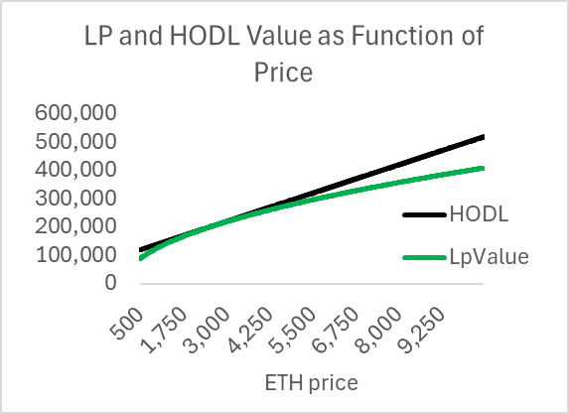
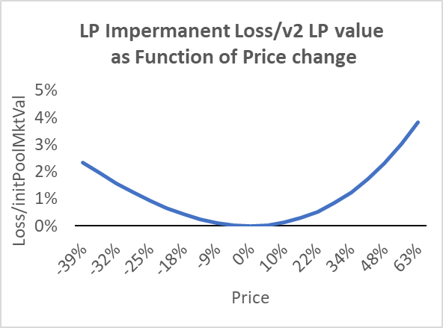
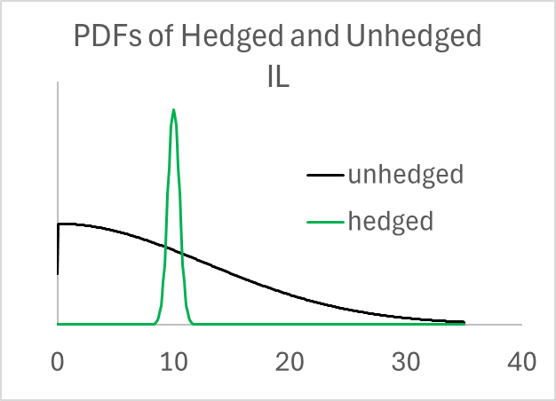


Problem: Capital Efficient AMM LPs Lose Money
PnL = fees – IL < 0
IL > fees
$$HODL value={usd}_{0}+{eth}_{0}∙p$$
hedging changes IL variance, not mean
$$LP value=2∙liq∙\sqrt{p}$$

Slide 3
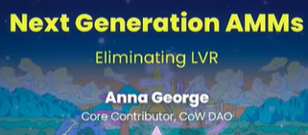
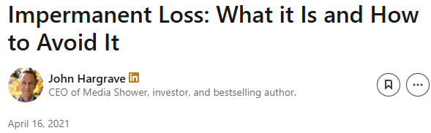
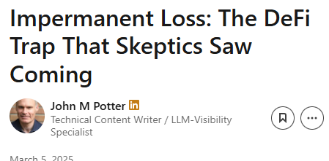
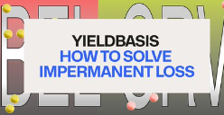

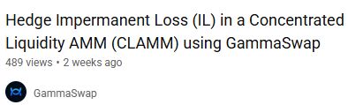
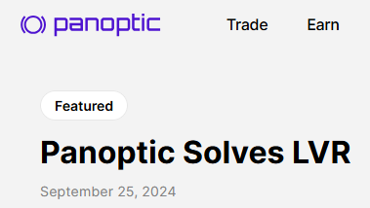
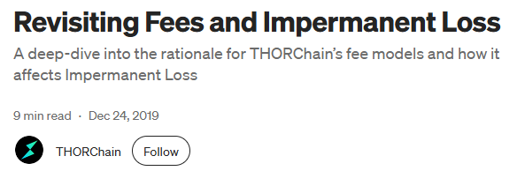

There are many takes on how to reduce or eliminate IL

Slide 4
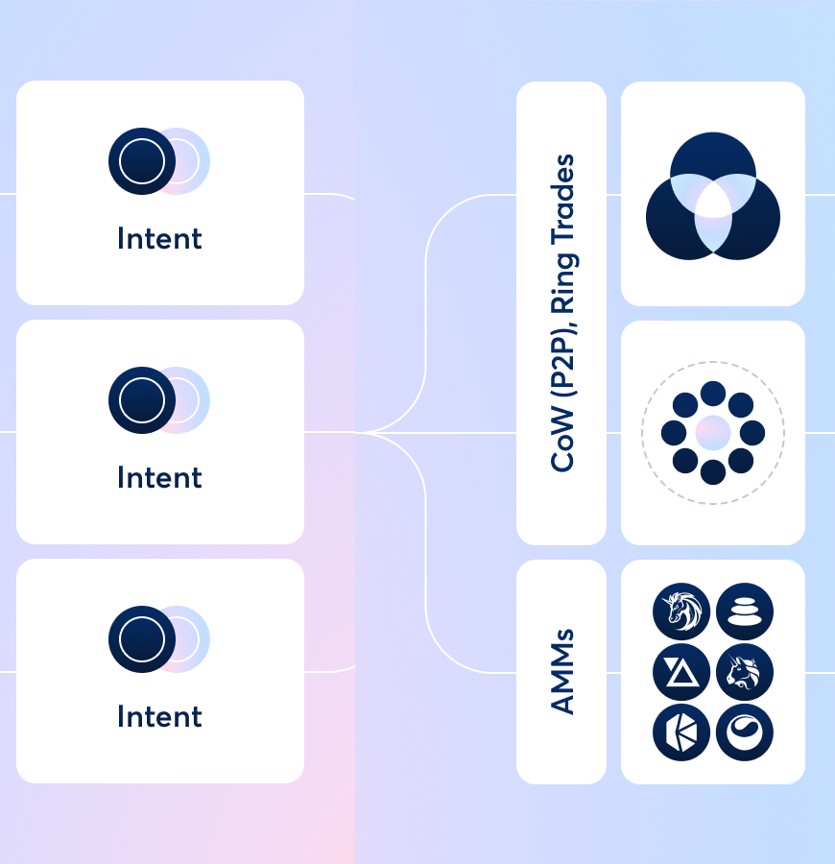
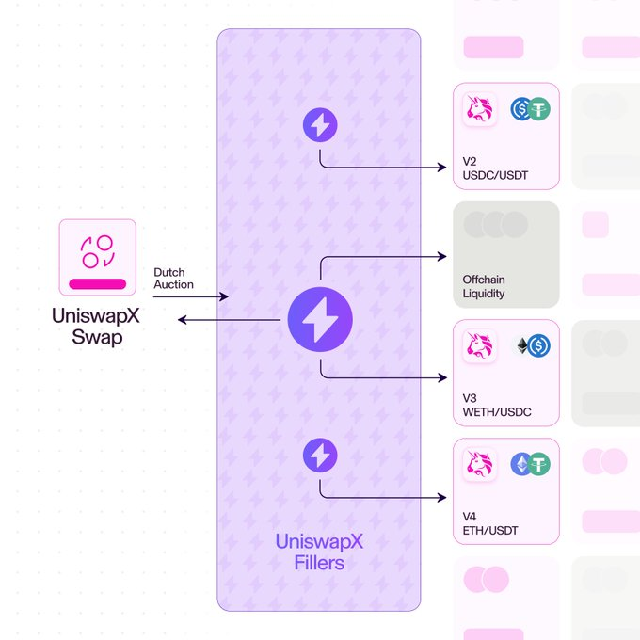
Auctions Good, But Not For LPs
CoW
UniSwapX

Slide 5
Quick Empirical Documentation of Problem

Slide 6
Nomenclature
Impermanent loss (IL) is a realization of an option-like return for an arbitrary start and end date
Though technically incorrect, following convention, I often use IL as a shorthand for Expected[IL] or ‘on average’
aka
  gamma decay
  convexity cost
  theta
  hedged LP PnL w/o fees
    loss-vs-rebalancing (LVR)
Can be derived/motivated 6 ways

Slide 7
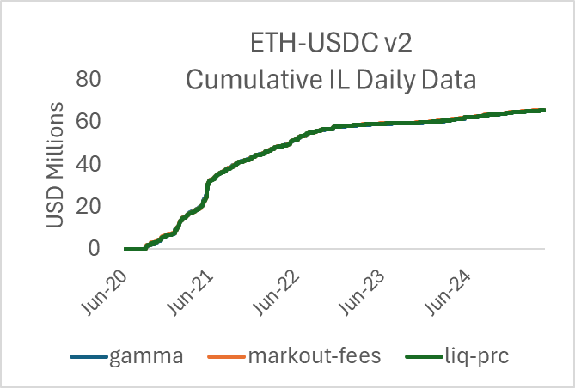
Measuring IL
Online AMM APYs are annualized fees / TVL
  no IL estimate
How I measure IL
These give similar results
  For v2, virtually identical, see chart
#1 easiest to calculate
  avoids liq-prc correlation issues in v3

Slide 8
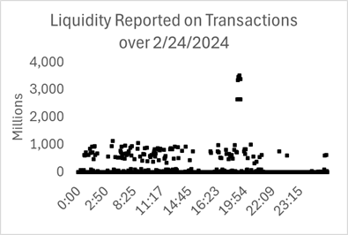
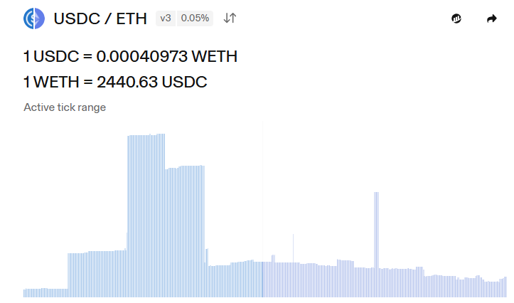
LP APY ambiguous for v3
Easy for v2
for v3
  JIT trading increases liq by 1000-fold
    simple average liquidity noisy
  LP leverage ranges from 1 to 1000
  Inactive ranges and TVL

Slide 9
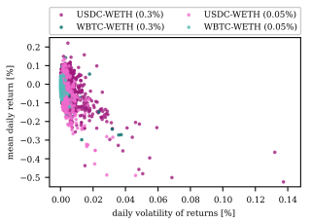
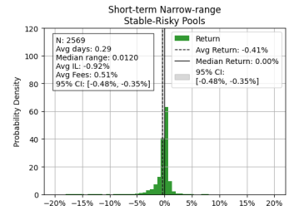
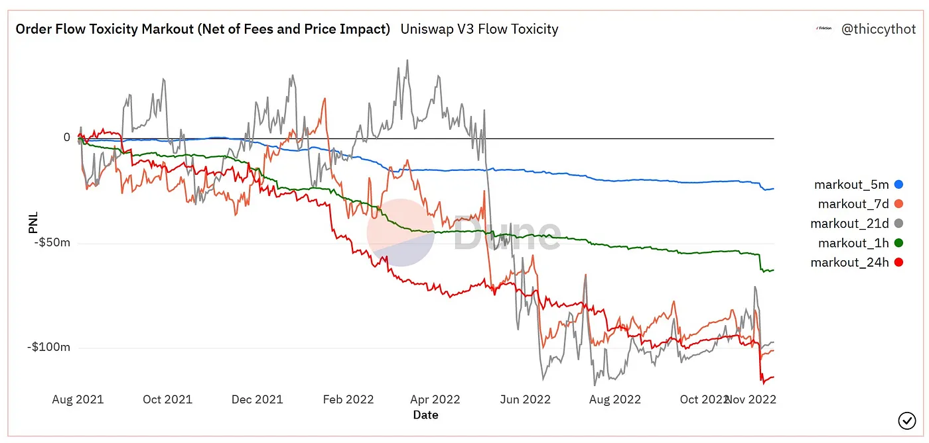
IL/fees
Most IL presentations are APYs, cumulative USD
  difficult to compare, assess statistical significance
In contrast, IL/fees is stationary, comparable across pools
intuitive: if expense/revenue > 1.0, LP loses money, regardless of leverage

Slide 10
type | pair | fee | chain | count | IL/Rev | t-stat =1 | ADV $MM
v2 | ETH-USDC | 30 | Ethereum | 60 | 0.51 | -16.35 | 25.91
v2 | ETH-USDT | 30 | Ethereum | 38 | 0.51 | -13.63 | 7.39
v2 | PEPE-ETH | 30 | Ethereum | 16 | 0.74 | -3.79 | 7.01
v2 | MKR-DAI | 30 | Ethereum | 9 | 1.74 | 3.45 | 5.95
v2 | ETH-USDC | 30 | Base | 10 | 0.27 | -8.76 | 1.73
v2 |  |  | Total v2 | 133 | 0.60 | -10.81
v3 | ETH-USDC | 5 | Ethereum | 48 | 1.32 | 4.41 | 374.23
v3 | ETH-USDC | 5 | Arbitrum | 30 | 1.13 | 2.37 | 67.14
v3 | BTC-ETH | 5 | Arbitrum | 7 | 1.48 | 2.29 | 62.45
v3 | ETH-USDC | 30 | Ethereum | 48 | 1.16 | 3.85 | 57.49
v3 | ETH-USDT | 5 | Arbitrum | 8 | 1.20 | 2.59 | 54.61
v3 | BTC-ETH | 5 | Ethereum | 28 | 1.26 | 2.44 | 53.37
v3 | ETH-USDC | 5 | Base | 20 | 1.23 | 2.52 | 43.77
v3 | ETH-USD | 30 | Ethereum | 28 | 1.11 | 1.65 | 20.45
v3 | AVAX-USDC | 22 | Avalanche | 25 | 1.31 | 5.84 | 17.46
v3 | BTC-ETH | 30 | Ethereum | 28 | 1.23 | 3.28 | 14.57
v3 | AVAX-USDC | 6 | Avalanche | 5 | 1.63 | 7.07 | 12.27
v3 | LINK-ETH | 30 | Ethereum | 29 | 1.04 | 0.55 | 9.55
v3 | UNI-ETH | 30 | Ethereum | 16 | 1.12 | 0.68 | 7.36
v3 | AVAX-USDC | 5 | Avalanche | 22 | 1.26 | 2.56 | 6.98
v3 | MKR-ETH | 30 | Ethereum | 16 | 1.33 | 2.12 | 4.30
v3 | PEPE-ETH | 30 | Ethereum | 16 | 0.85 | -2.08 | 4.01
v3 | SHIB-ETH | 30 | Ethereum | 25 | 0.63 | -5.59 | 0.83
v3 | ANYONE-ETH | 100 | Ethereum | 10 | 0.70 | -4.53 | 0.27
v3 |  |  | Total v3 | 409 | 1.16 | 6.91
v2 profitable but unpopular
Data in my Measuring and Mending LP Net Profitability paper
v3 popular but unprofitable

Slide 11
Drill Down into Arb Data
five ETH-USD Uniswap pools on Ethereum
Data from 4/1/24-4/30/25

Slide 12
Pool Data Apr 24-May ‘25
group | Pool PnL | fees | % Volume
ETH-USDC 5 bp v3
Total | -30,532 | 133,352 | 100%
other traders | 58,814 | 35,942 | 26%
router traders | 41,636 | 15,073 | 12%
arbTot | -130,981 | 82,337 | 62%
ETH-USDC 30 bp v3
Total | -16,401 | 62,755 | 100%
other traders | 2,574 | 10,507 | 17%
routers | 1,665 | 4,834 | 9%
arbTot | -20,640 | 47,413 | 74%
ETH-USDT 30 bp v3
Total | -16,380 | 92,902 | 100%
other traders | 10,803 | 14,574 | 16%
routers | 5,220 | 9,329 | 11%
arbTot | -32,403 | 68,999 | 73%
ETH-USDC 30 bp v2
Total | 8,585 | 15,920 | 100%
other traders | 9,924 | 3,503 | 16%
routers | 6,261 | 6,088 | 43%
arbTot | -7,599 | 6,329 | 41%
ETH-USDT 30 bp v2
Total | 10,401 | 23,412 | 100%
other traders | 12,408 | 5,031 | 18%
routers | 7,452 | 8,959 | 43%
arbTot | -9,458 | 9,421 | 39%

Slide 13
Heterogeneous Arbs
arb # | pnl | net traded | simple APY | gas P | gas $ | tx costs | net APY*
ETH-USDC 5 bp v3
2 | 40,973 | 8,901,478 | 56% | 32 | 4,490 | 4,451 | 44%
3 | 20,329 | 1,694,403 | 146% | 114 | 20,368 | 847 | -6%
4 | 101,435 | 6,689,174 | 184% | 3 | 367 | 3,345 | 178%
5 | -3,906 | 3,240,988 | -15% | 43 | 3,529 | 1,620 | -34%
ETH-USDC 30 bp v3
2 | 9,416 | 1,739,172 | 66% | 32 | 1,014 | 870 | 53%
3 | -209 | 514,060 | -5% | 114 | 2,565 | 257 | -72%
4 | 12,432 | 1,406,854 | 108% | 3 | 51 | 703 | 101%
5 | 1,784 | 833,155 | 26% | 43 | 580 | 417 | 12%
 | pnl | net traded | simple APY | gas P | gas $ | tx costs | net APY*
ETH-USDC 5 bp v3 | 158,831 | 20,526,043 | 94% | 31 | 28,754 | 10,263 | 71%
ETH-USDC 30 bp v3 | 23,424 | 4,493,241 | 63% | 34 | 4,209 | 2,247 | 46%
ETH-USDT 30 bp v3 | 34,945 | 6,193,935 | 69% | 47 | 4,918 | 3,097 | 53%
ETH-USDC 30 bp v2 | 12,354 | 873,236 | 172% | 35 | 3,626 | 437 | 116%
ETH-USDT 30 bp v2 | 13,423 | 794,756 | 205% | 25 | 3,002 | 397 | 153%

Slide 14
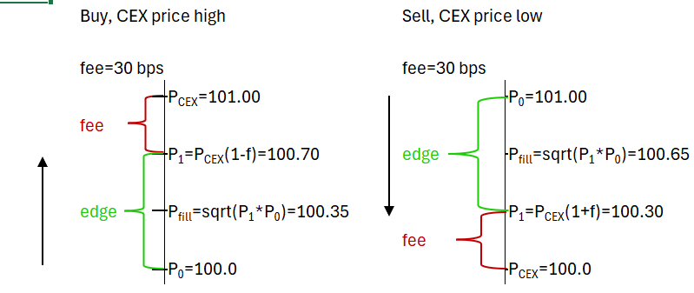
Simple Arb Behavior
Simple task: update AMM to CEX price
AMMs will always lag tradfi CLOBs
  CEX arbs operate < 10 milliseconds
  Decentralized AMM > 250 milliseconds
Unlike CLOB arbs, no alpha required
Risk management not trivial
ETH mainnet Uniswap AMMs Basis points from CEX price at AMM end of trade price
(CEX/AMM -1)*1e4 for buys, (AMM/CEX-1)*1e4 for sells

Slide 15
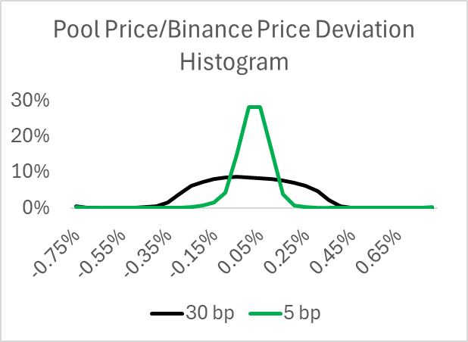
Opportunistic Arb Behavior
For illiquid pools, most arb profit backrunning large trades
  noise trader arb
 |  |  | Daily Arb Net PnL
fee | v | eth- | Total | BackRun | % trades | trigger | grProfit/IL
5 | v3 | usdc | 130,981 | 23,042 | 10% | > 5bps | 130%
30 | v3 | usdc | 20,640 | 23,456 | 11% | > 15bps | 86%
30 | v3 | usdt | 32,403 | 26,605 | 11% | > 15bps | 93%
30 | v2 | usdc | 7,699 | 23,080 | 15% | > 15bps | 190%
30 | v2 | usdt | 9,532 | 14,922 | 13% | > 15bps | 145%

Slide 16
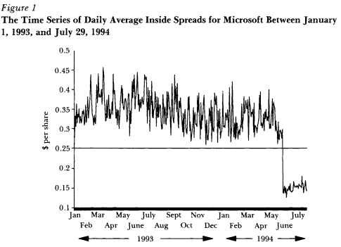
Arbs Can and Will Collude
repeated auctions on a divisible common asset create an incentive to collude
  Prisoner’s Dilemma to Tit-for-Tat
In early 90’s, Nasdaq dealers (~60) avoided quoting odd-eighths to maintain wider bid-ask spreads {1/8, ¼, 3/8, ½, 5/8, ¾, 7/8}
Notes:
With repeated sales of a divisible or common asset, bidders may form a pool and take turns winning at low prices.
60 Nasdaq dealers avoided quoting odd-eighths to maintain wider bid-ask spreads and thus higher trading profits, enforced by informal pricing conventions and harassment among dealers

Slide 17
Solution: Integrate arbs into AMMs
few arbs make it easier to collude
  most pools have 3-7 active arb accounts
opportunism potential is high
  integration can better align incentives than oracles or auctions
Particular AMM LP-Arb capital complementarity efficiency
  arb token requirements complement LP token requirements
essential but replaceable
  just need base arb APY > hurdle rate (eg, 20%)

Slide 18
Solution: Specifics for AMMs
LPs and arbs get margin accounts
  leverage, have debit accounts on contract
LPs and arbs swap collateral
  helps with contract solvency
  reduces off-chain transaction costs
  capital efficiency w/o bad v3 effects
Arbs get zero fee
  LP’s get 90% of arb’s profit
  Chainlink gets 2% of GMX fees for low-latency service
  hedge fund pms get 10% of pnl

Slide 19
Start with Worst Case Scenario
Liquidation
With leverage, bankrupt accounts possible
Need mechanism to protect contract
  one bankrupt account leads to ‘bank run’

Slide 20
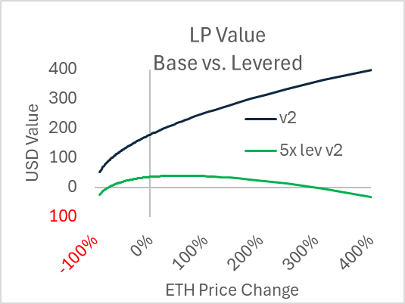
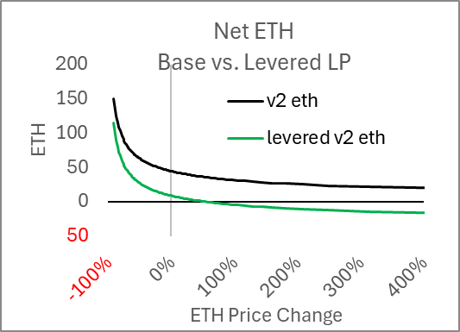
LP Default
token deficiency, not net value, most pressing risk

Slide 21
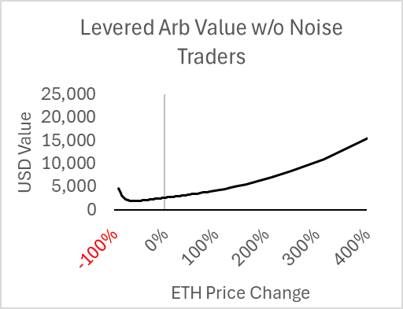

Arb Default
arb account value > RiskyTokenValue/5
active arbs should make a profit
stuff happens
start
pushes price down
does nothing when price rises

Slide 22
Arb and LP Collateral Swapping
Arb token changes mirror LP token changes
  arb ETH surplus → LP ETH deficit
  arb USDC deficit → LP USDC surplus
Policy
Swap condition on arb trade
  threshold criteria: LP net ETH balance > x% of pool
  mutual benefit: LP and arb net ETH balance offset
LP maintains constant liquidity
LP and arb account values unaffected by swap
on average token changes offset

Slide 23

LP & Arb Collateral Swap Example
Arb ETH excess = -14.2
LP ETH excess = +11.25

Slide 24
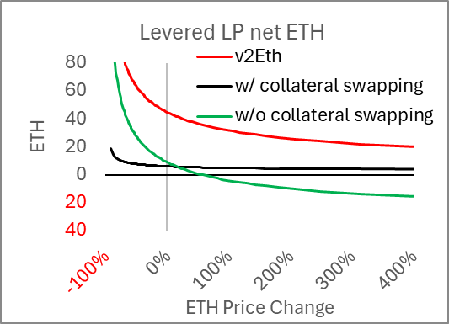
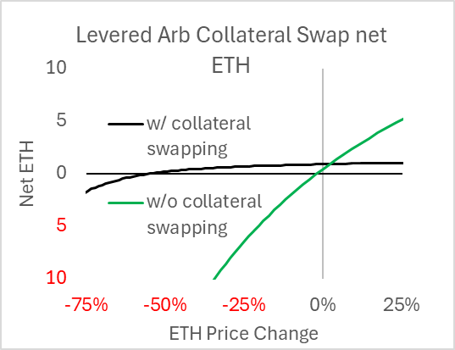
LP and Arb ETH Balances w/ Swapping
Expands solvency
Lowers off-contract trading

Slide 25
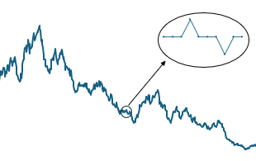
Arb High-Level Pro-Forma APY
noise trade arb not related to IL harvesting arb
Arb profits
  IL: IL = arb profit = 5.6% v2 mktcap (3.6% daily vol)
  Add Noise: 5.6% → 7%
Arb capital
  5% of v2 mkt cap needed for potential 10% price move
  Levered 5:1 → 1% of v2 mktcap needed
7%/1% = 700% ROE
Let them keep 10%: 70% ROE

Slide 26
Arb Pro Forma Using Actual Arb Data
arb profit
  current: excludes gas, includes fees
  proposed: 10% of actual arb gross pnl (net pnl + arb fees)
arb capital assumptions
  current: 5% daily net USD stdev
  proposed: 1% of v2 mkt cap
not modeled: saving on off-chain trading costs and gas
 | USDC | USDC | USDT | USDT | USDC
 | v3 5bp | v3 30bp | v3 30bp | v2 30bp | v2 30 bp
arb % tradeVolume | 64% | 72% | 70% | 42% | 40%
Current arb net profit | 130,981 | 20,640 | 32,403 | 7,599 | 9,458
current APY* | 94% | 63% | 69% | 172% | 205%
Proposed arb pnl | 21,332 | 6,805 | 10,140 | 1,393 | 1,888
Proposed APY* | 67% | 50% | 53% | 58% | 98%

Slide 27
LP Pro Forma Using Actual Arb Data
LP net profit = 0.9 * (arb net profit + fees paid)+noise fees − IL
LP capital 20% of v2 mkt cap
derived using 13 months of data from April 2024 through April 2025.
 | ETH-USDC | ETH-USDC | ETH-USDT | ETH-USDT | ETH-USDC
 | v3 5bp | v3 30bp | v3 30bp | v2 30bp | v2 30 bp
daily $ IL | 170,545 | 80,692 | 115,469 | 13,258 | 10,817
Curr LP net profit | -37,193 | -17,937 | -22,567 | 2,662 | 12,595
proposed LP net Profit | 72,456 | -4,102 | -304 | 8,869 | 20,165
Proposed Net APY* | 11.4% | -1.5% | -0.1% | 18.5% | 52.5%

Slide 28
Miscellaneous
minimum trade size for arbs
  prevent excessive arb competition
gas price limit for arbs
  gas price competition dead weight loss for AMM
fee should be > 5bp
  liquid equity trading costs 5-8 bps
  front ends charge 15-50 bps
Leverage creates use case for equity token
Extension to trader leverage straightforward
  perps
RobinHood or Coinbase could run a version where their centralized arb bot gives all pnl to LPs
  subject to expropriation, and permissioned, but at least more secure & transparent

Slide 29
References
https://efalken.substack.com/p/deriving-lvr-six-ways
https://efalken.substack.com/p/amm-with-whitelisted-arbs
https://papers.ssrn.com/sol3/papers.cfm?abstract_id=5274557
Python of LP and arb simulation with collateral swapping

